Slide 1

British Airlines
Flight Feature Analysis

Slide 2
Key Insights:
Important Variable : Purchase Lead
Model Info:
Precision:0.575
Recall: 0.111

Slide 3
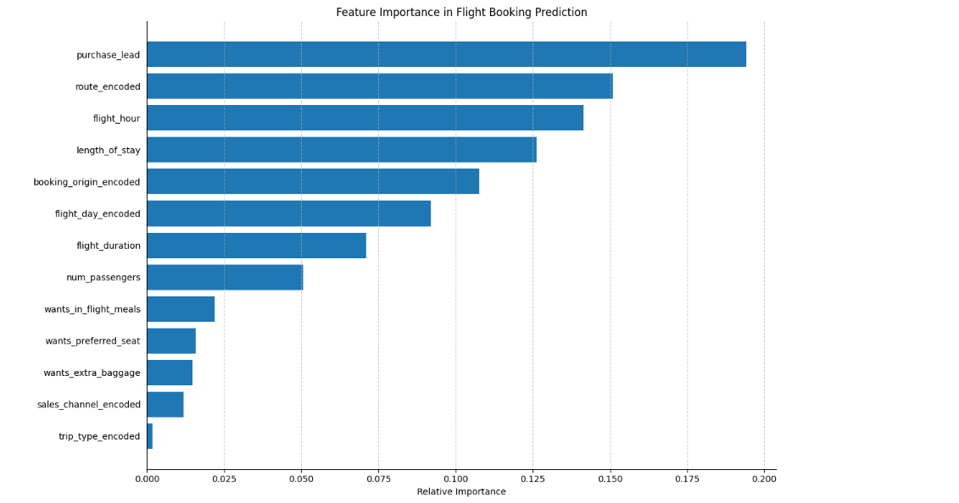
Key Features:

